Slide 1
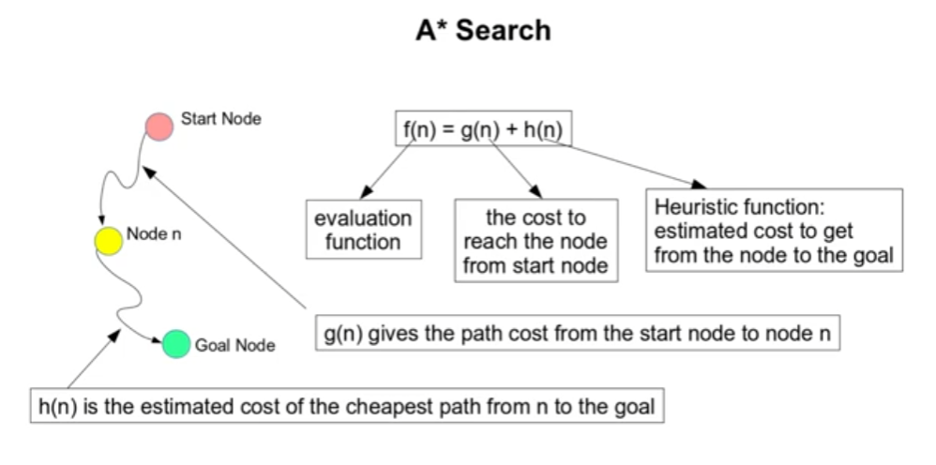
A* Search Algorithm

Slide 2
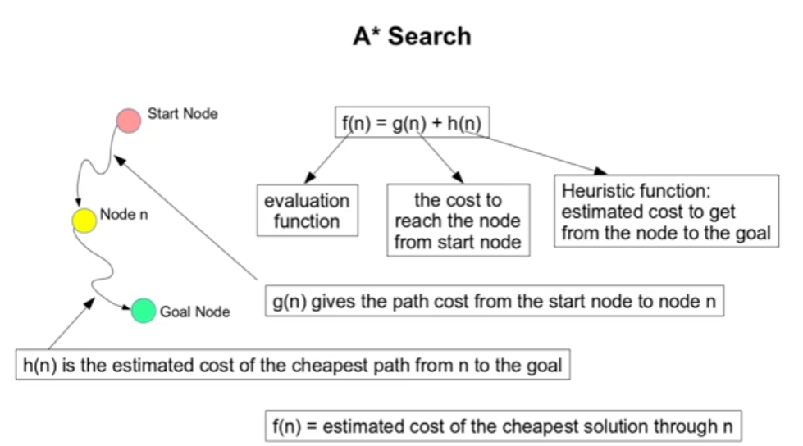
Heuristic Function and its application

Slide 3
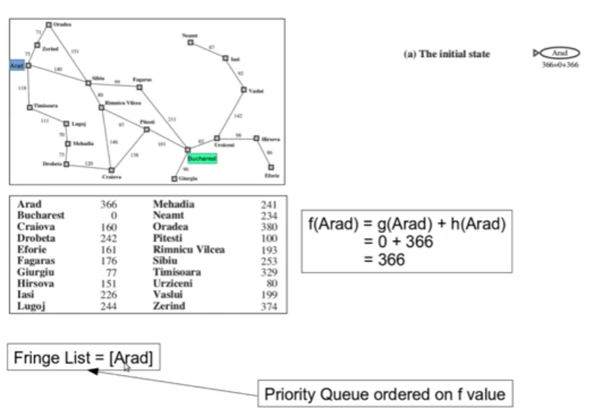
Heuristic Function and its application

Slide 4
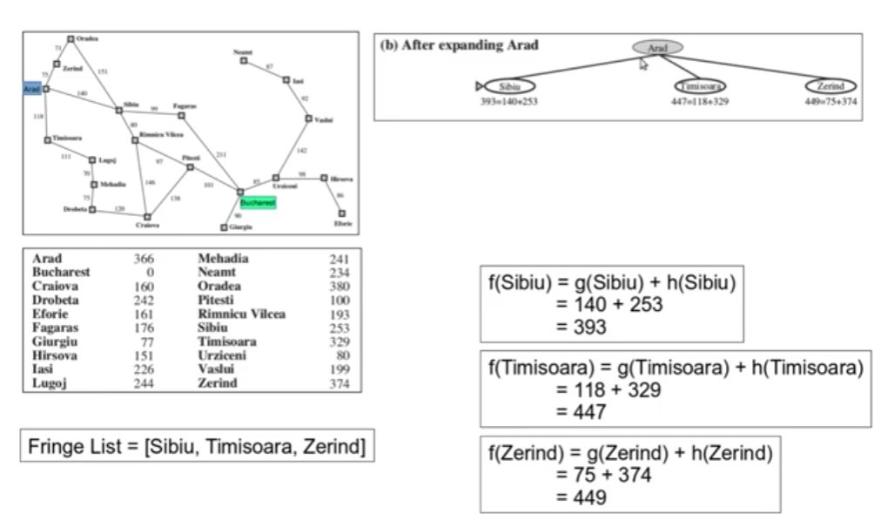
Heuristic Function and its application

Slide 5
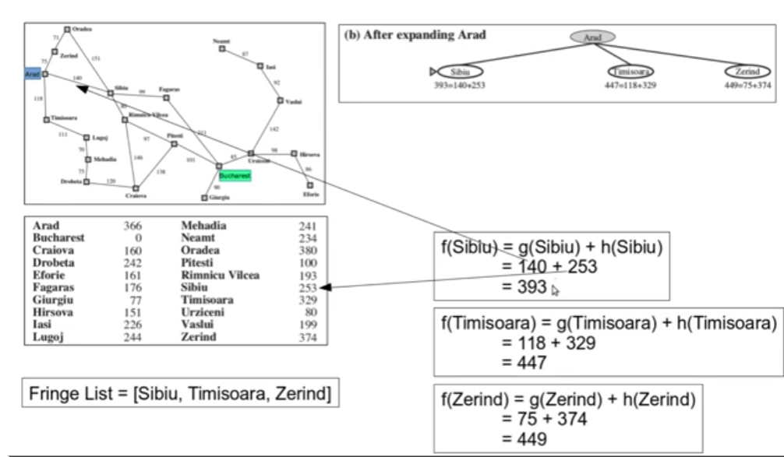
Heuristic Function and its application

Slide 6
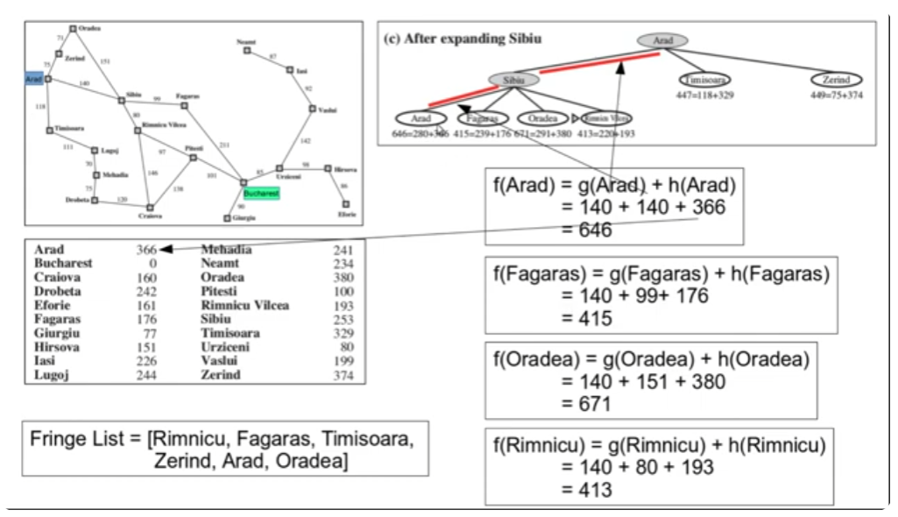
Heuristic Function and its application

Slide 7
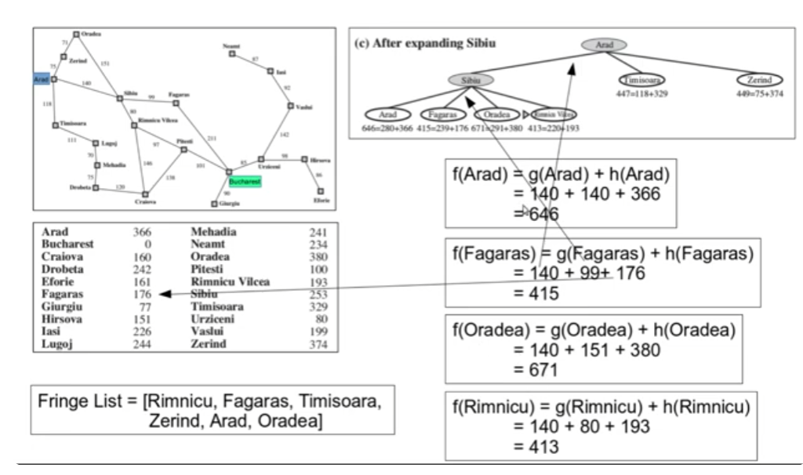
Heuristic Function and its application

Slide 8
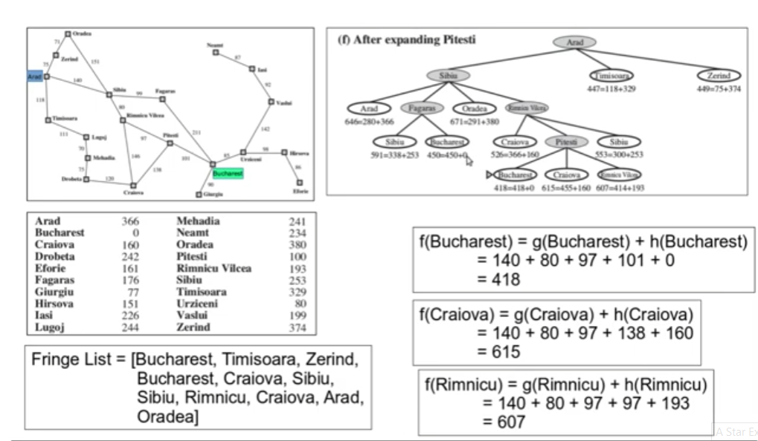
Heuristic Function and its application

Slide 9
Heuristic Function and its application
If there are no specific answers to a problem or the time required to find one is too great, a heuristic function is used to solve the problem. The aim is to find a quicker or more approximate answer, even if it is not ideal.
A heuristic function (algorithm) or simply a heuristic is a shortcut to solving a problem when there are no exact solutions for it or the time to obtain the solution is too long.
Heuristic search algorithms have the following properties:
Admissible Condition: If an algorithm produces an optimal result, it is considered admissible.
Completeness: If an algorithm ends with a solution, it is considered complete.
Dominance Property: If A1 and A2 are two heuristic algorithms and have h1 and h2 heuristic functions, respectively, then A1 Will dominate A2 if h1 is superior to h2 for all possible values of node n.
Optimality Property: If an algorithm is thorough, allowable, and dominates the other algorithms, that'll be the optimal one and will unquestionably produce an optimal result.

Slide 10
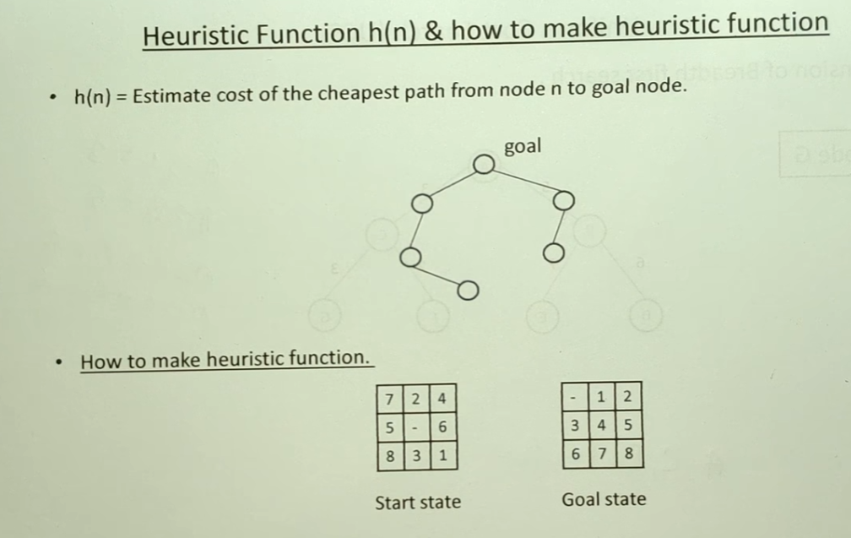
Heuristic Function h(n) and how to make it

Slide 11
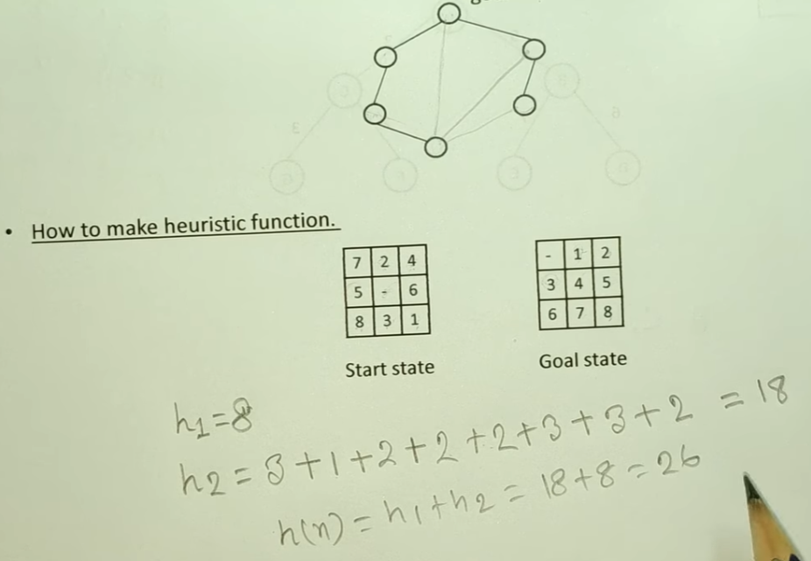
Heuristic Function h(n) and how to make it

Slide 12
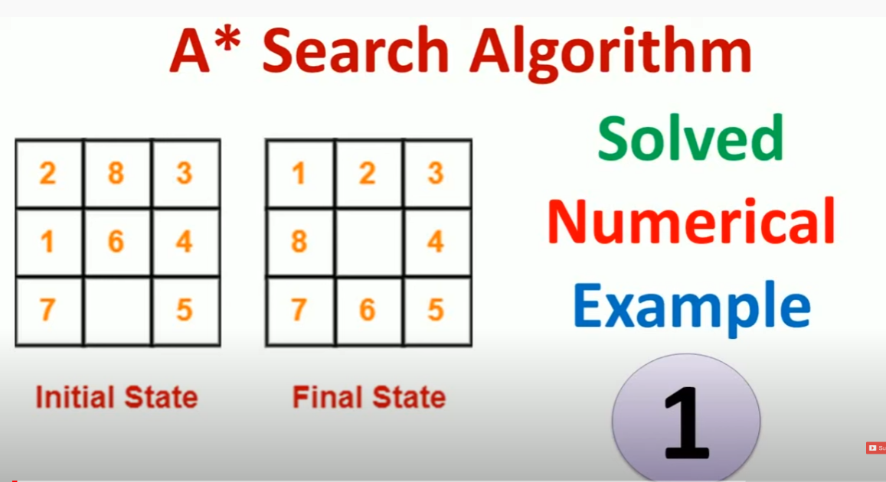
A* Search Algorithm
A* Search Algorithm solved with numeric example

Slide 13
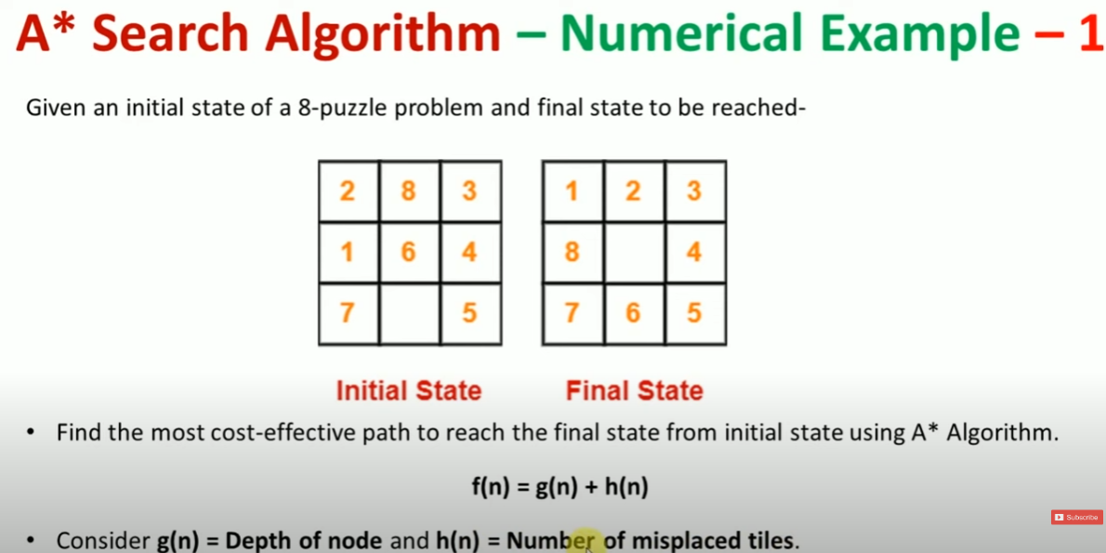
A* Search Algorithm solved with numeric example

Slide 14
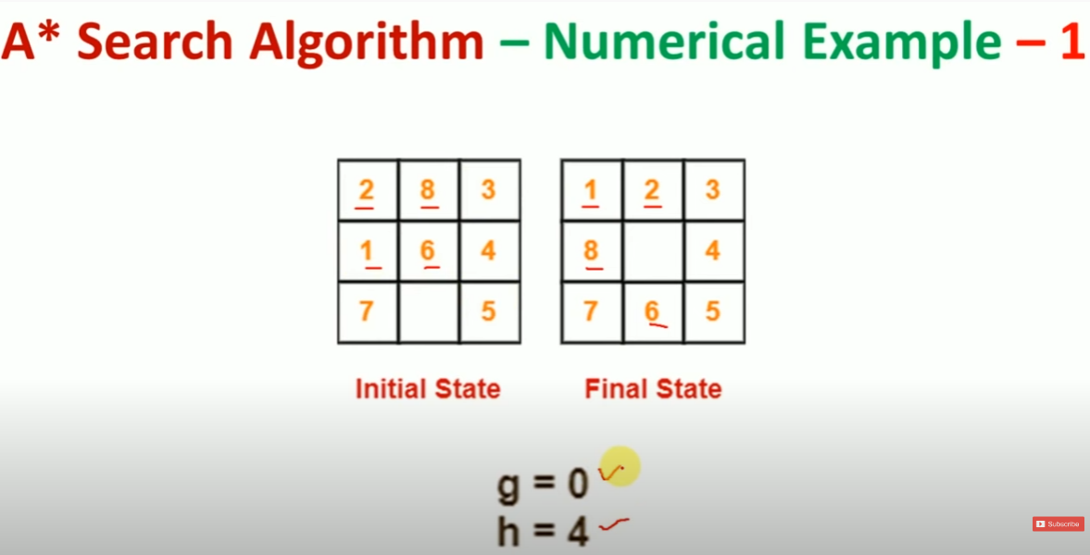
A* Search Algorithm solved with numeric example

Slide 15
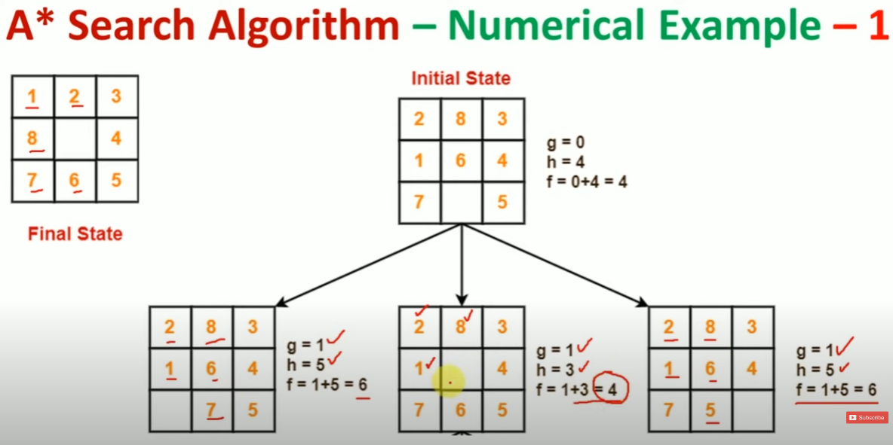
A* Search Algorithm solved with numeric example

Slide 16
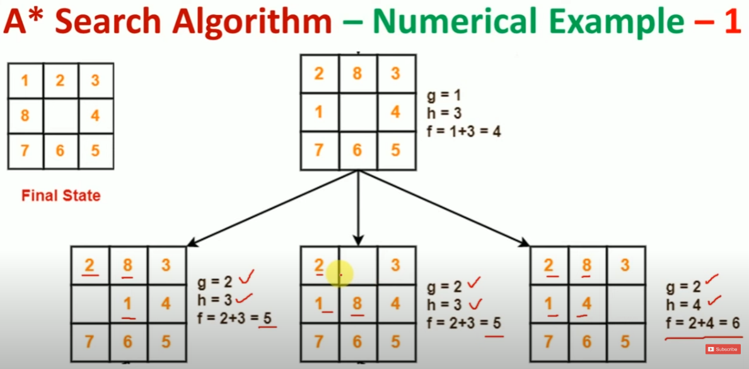
A* Search Algorithm solved with numeric example

Slide 17
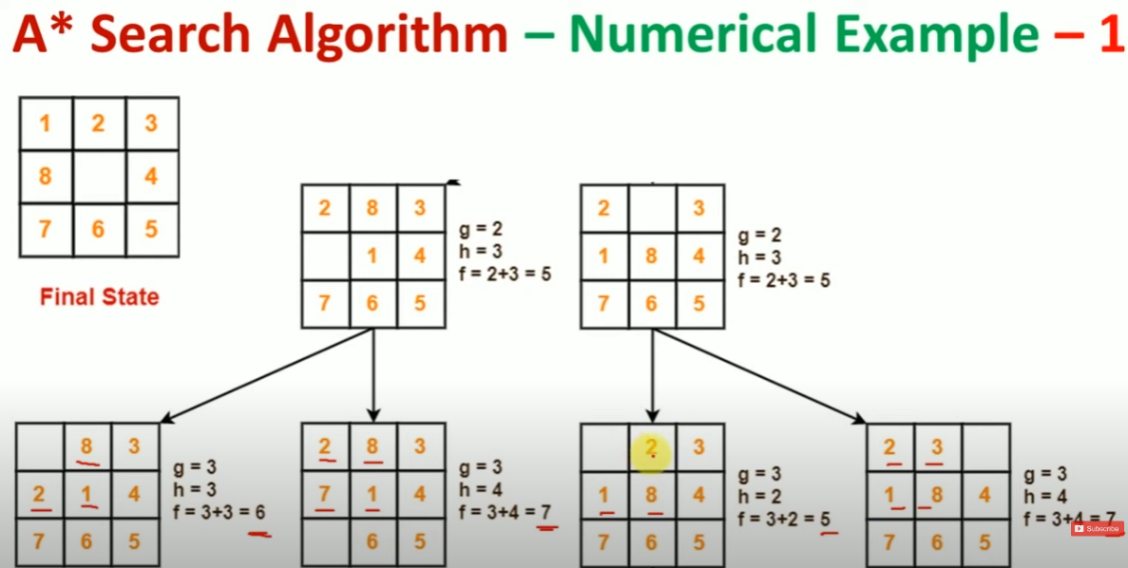
A* Search Algorithm solved with numeric example

Slide 18
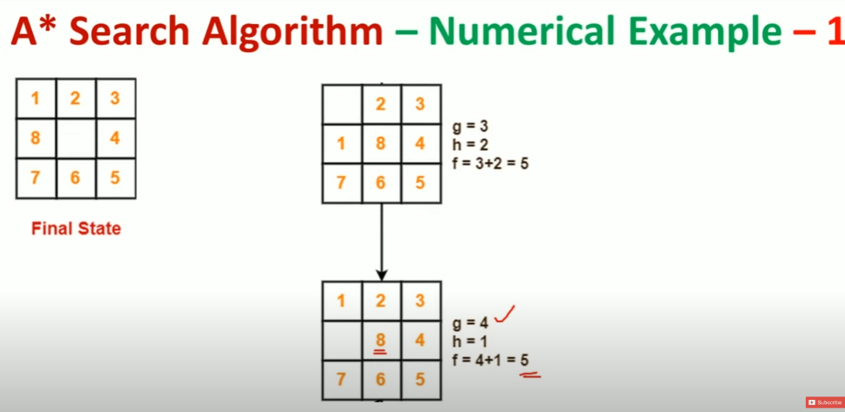
A* Search Algorithm solved with numeric example

Slide 19
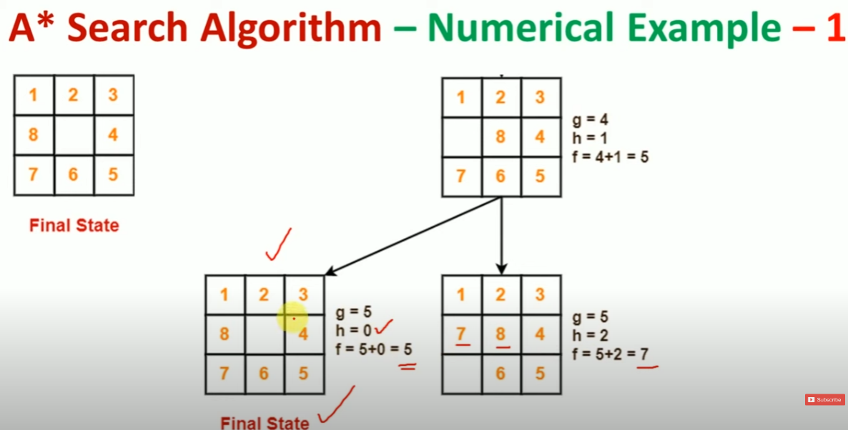
A* Search Algorithm solved with numeric example

Slide 20
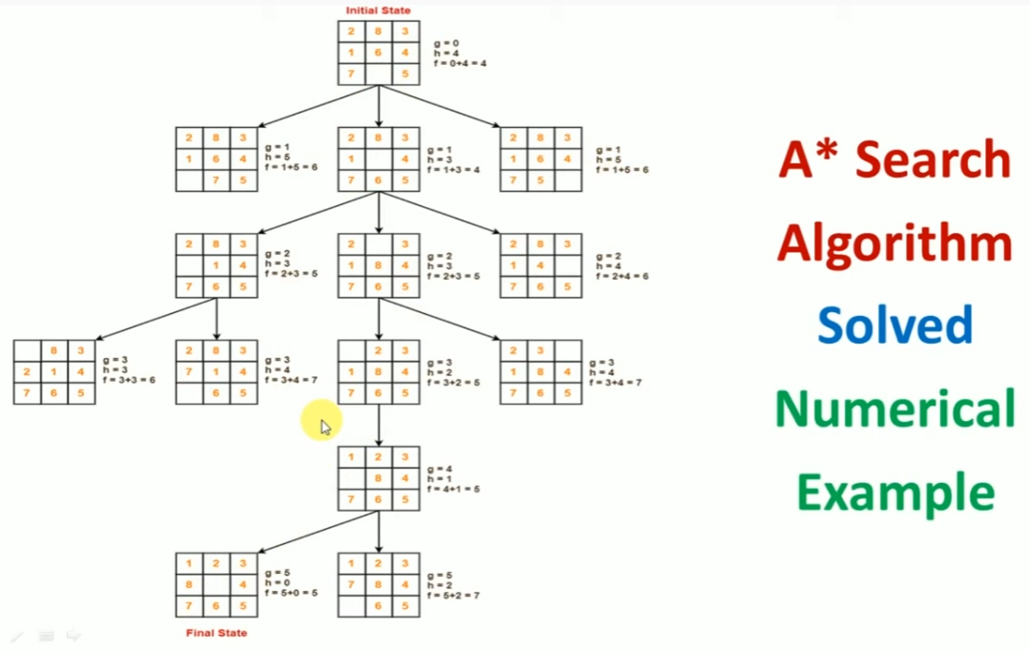
A* Search Algorithm solved with numeric example

Slide 21
Optimality of A* Search Algorithm
Heuristic may be:
h(n) > actual cost
h(n) = actual cost
h(n) < actual cost
(1) h(n) > actual cost [Optimum solution can be overlooked, optimum solution is not possible]
(2) h(n) = actual cost [Best case scenario, if h(n) approximates actual cost, searching uses minimum of node to the goal]
(3) h(n) < actual cost [ Admissible, Consistent Heuristics]

Slide 22
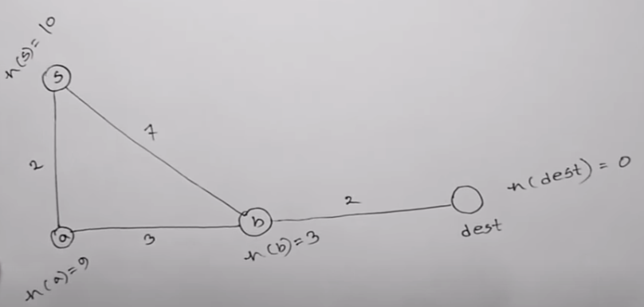
Optimality of A* Search Algorithm
h(n) > actual cost [Optimum solution can be overlooked, optimum solution is not possible]

Slide 23
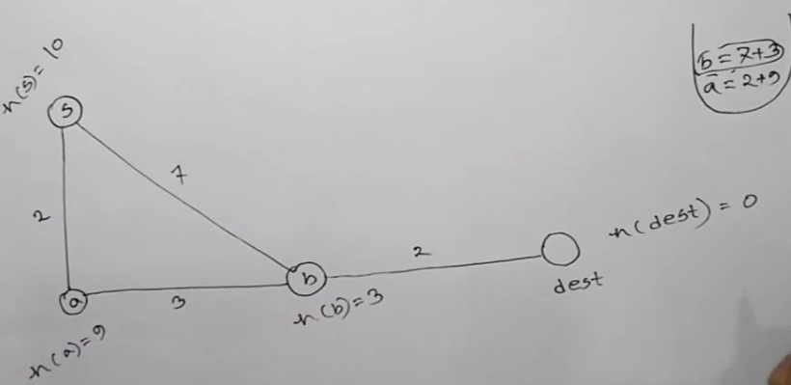
Optimality of A* Search Algorithm
h(n) > actual cost [Optimum solution can be overlooked, optimum solution is not possible]

Slide 24
Optimality of A* Search Algorithm
h(n) > actual cost [Optimum solution can be overlooked, optimum solution is not possible]
for node a
From start s to node a, push at priority queue (2+9(h)=11)
From start to b and push at priority queue (7+3(h)=10) )
So, here we will pop b then explore the neighbors of b, which are a and dest
Now, a is visited, we will pop dest now the cost to dest = 7+2+0=9. This is the solution using A* search.
But, the optimal solution is s->a->b->dest, opt. cost = 2+3+2=7.
A* is doe not provide optimal solution because heuristic cost is more than actual cost.

Slide 25
Optimality of A* Search Algorithm
h(n) > actual cost [Optimum solution can be overlooked, optimum solution is not possible]
b………….> dest and cost (7+2+0=9) , or ……….>a and cost (2+9=11)
Actual cost from S🡪a🡪b🡪dest =2+3+2=7
h(n)=10 > actual cost = 7

Slide 26
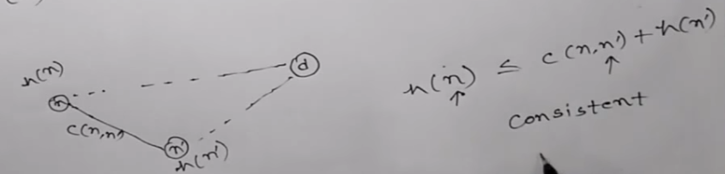


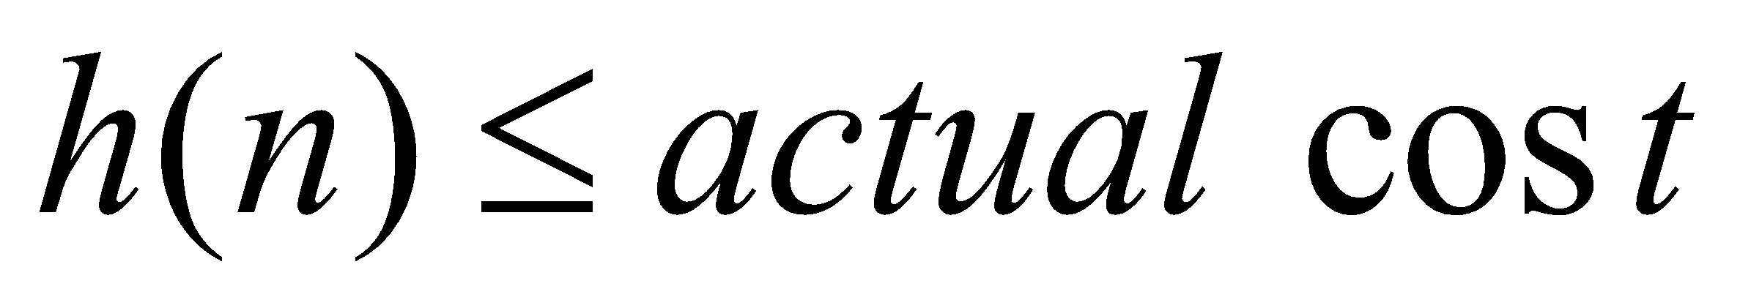
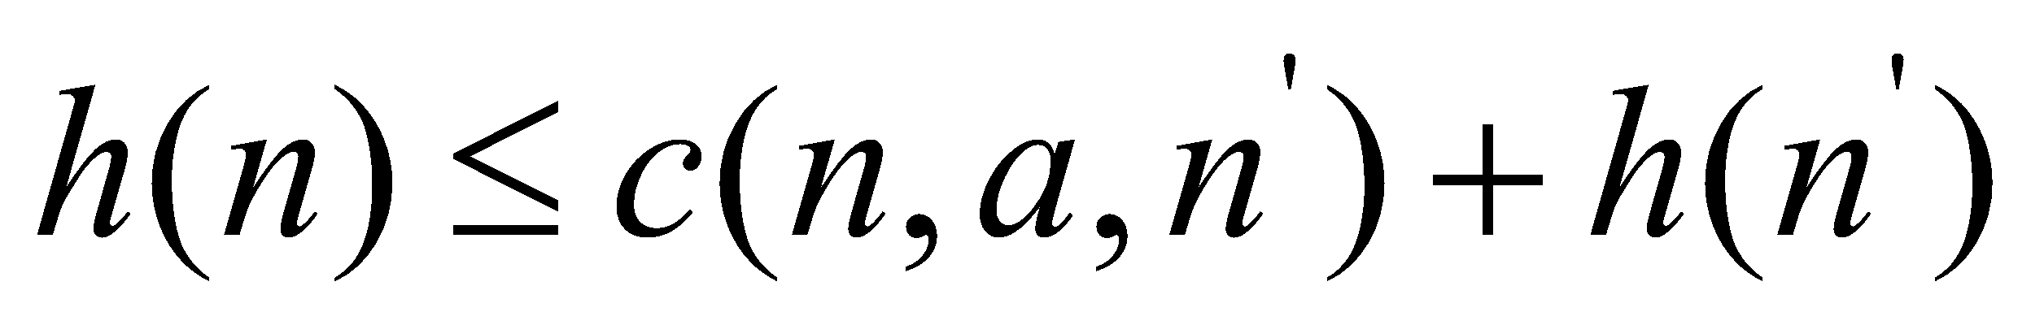
Optimality of A* Search Algorithm
Admissible heuristic: An admissible heuristic is one that never overestimates the cost to reach the goal. Because g(n) is the actual cost to reach n along the current path, and f(n)=g(n) + h(n), we have as an immediate consequence that f(n) never overestimates the true cost of a solution along the current path through n.
Consistent heuristic: A heuristic h(n) is consistent if, for every node n and every successor n’ of n generated by any action a, the estimated cost of reaching the goal from n is no greater than the step cost of getting to n’ plus the estimated cost of reaching the goal from n’:
Optimal solution is guaranteed in this case.
h(n)=h_{SLD}
d
n
c(n,n’) actual cost
n’
h(n’)=h_{SLD}

Slide 27
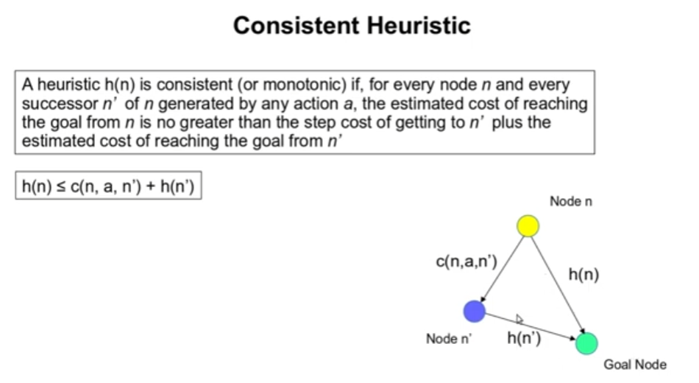
Optimality of A* Search Algorithm

Slide 28
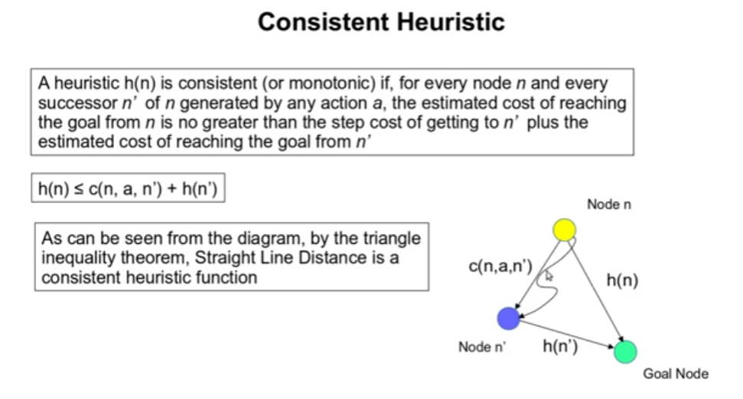
Optimality of A* Search Algorithm

Slide 29
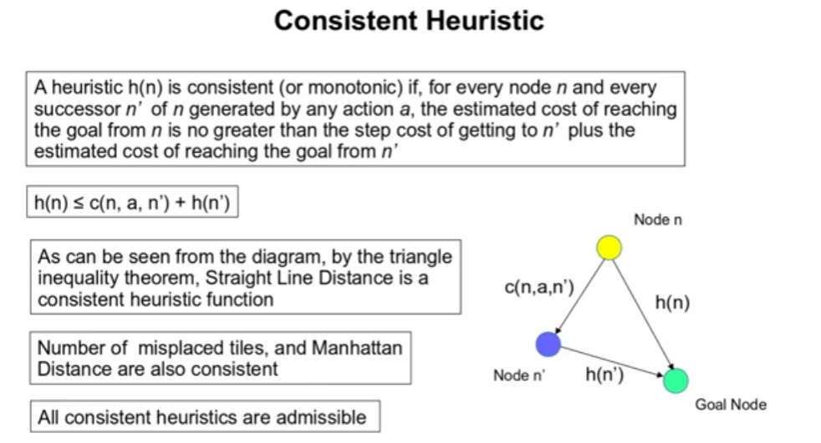
Optimality of A* Search Algorithm

Slide 30
Optimality of A* Search Algorithm

Slide 31
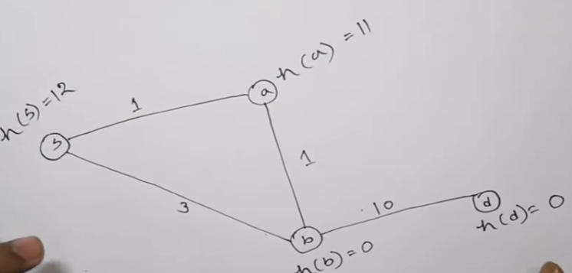
Optimality of A* Search Algorithm
We will see the case that the heuristic admissible but not consistent……………..

Slide 32
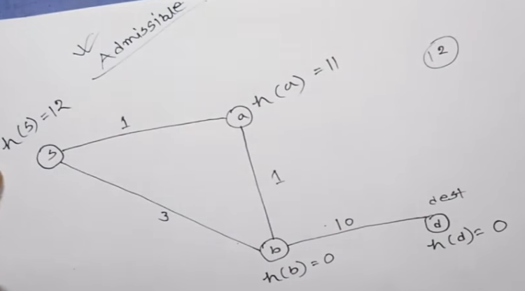
Optimality of A* Search Algorithm
Is it admissible?
Shortest distance from S ---🡪 dest is 1+1+10 =12 [12]
For node S, h(s)=12 ≤ 1+1+10 = 12 [S->a->b->d] or h(S)=12 ≤ 3+10=13 [S->b->dest]
For node a, h(a)=11 ≤1+10=11[a->b->d]
For node b, h(b)=0 ≤10
Therefore, this is admissible heuristic.

Slide 33
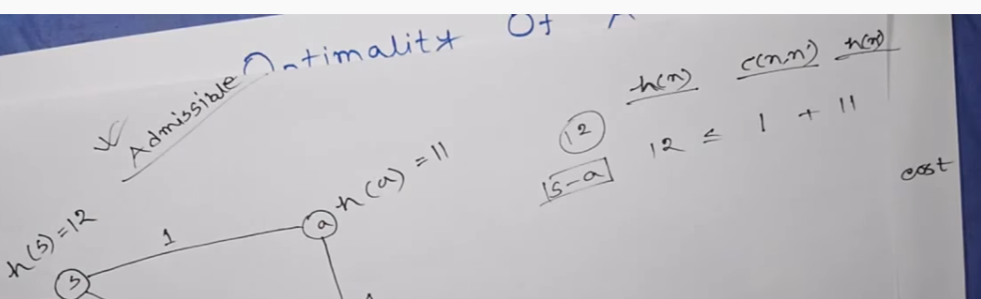
Optimality of A* Search Algorithm
We will see the case that the heuristic admissible but not consistent……………..

Slide 34
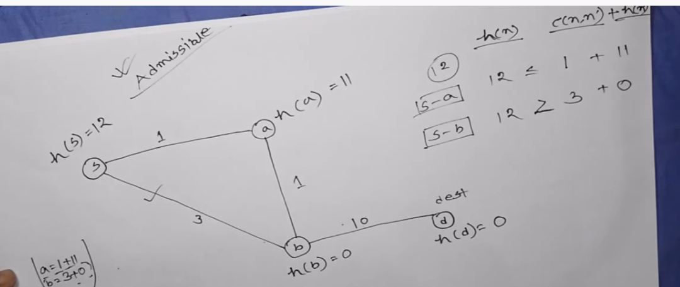
Optimality of A* Search Algorithm
We will see h(n) c(n,n’) + h(n’)
S to a 12 ≤ 1 + 11
S to b 12 ≥ 3 + 0 [not satisfied condition]
Therefore, this heuristic is admissible but not consistent.

Slide 35
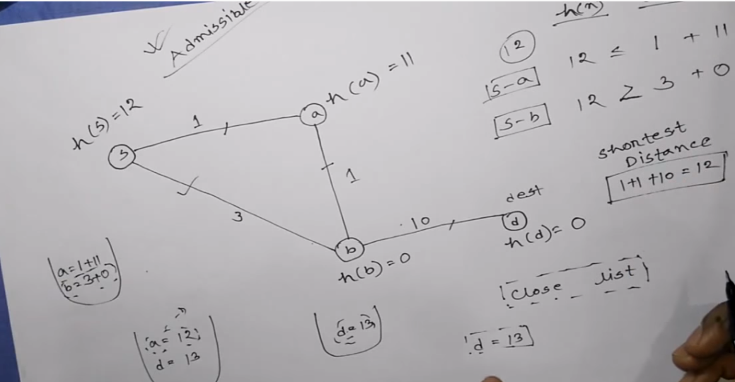
Optimality of A* Search Algorithm
If Heuristic admissible but not consistent, it may not be provided optimum solution.
If we apply A* search algorithm in this example.
Starting node, S has two successors a and b. S push two value into priority queue
[a=1+11=12, b=3+0=3], we pop the value of b and remained [a=1+11=12
Node b has two successors a and d whereas a is visited, so we will push the value of d
[a=12, d=3+10=13] then we pop a and remained [d=13], d=13 is the solution.
The solution is not optimal. We know, here, optimal solution is 12.
If Heuristic admissible but not consistent, it may not be provided optimum solution.

Slide 36
Optimality of A* Search Algorithm
If Heuristic admissible but not consistent, it may not be provided optimum solution.
For optimum solution, heuristic must be consistent. If it consistent, it must be admissible.

Slide 37
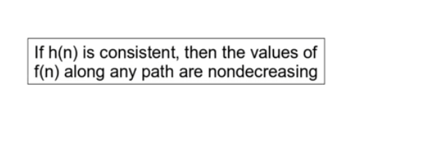
Optimality of A* Search Algorithm

Slide 38
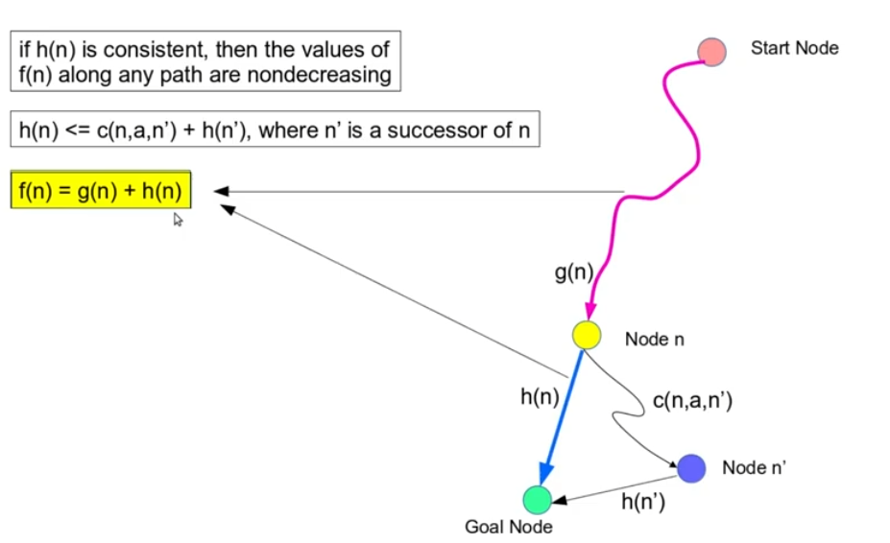
Optimality of A* Search Algorithm

Slide 39
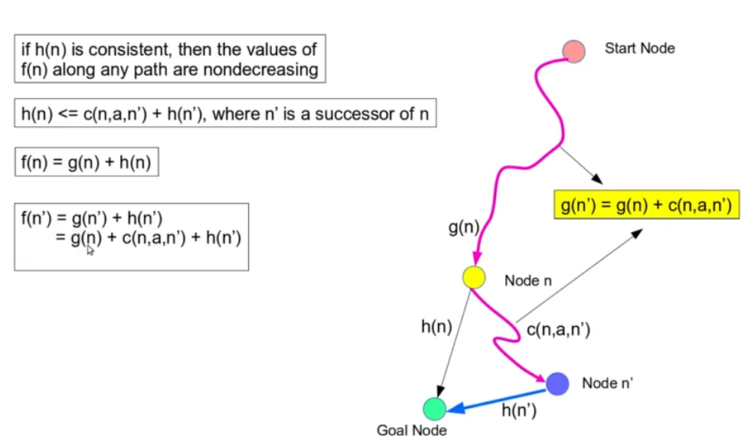
Optimality of A* Search Algorithm

Slide 40
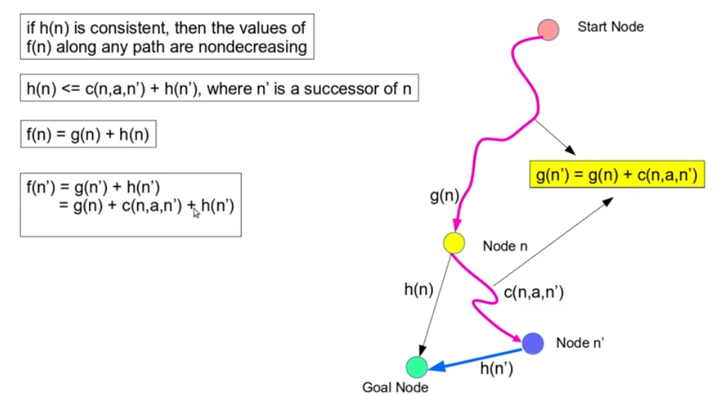
Optimality of A* Search Algorithm

Slide 41
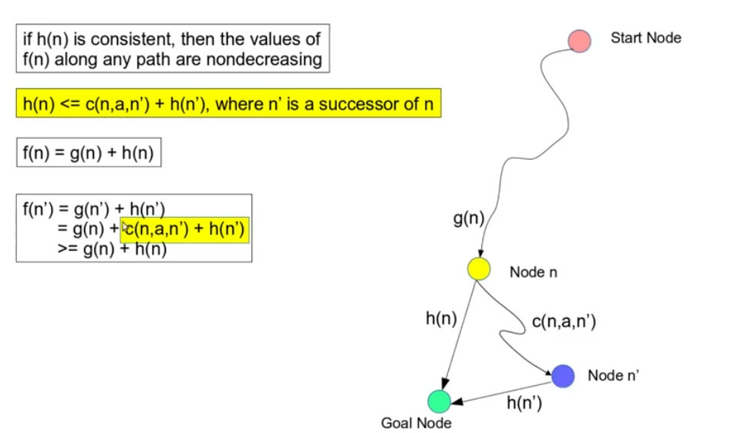
Optimality of A* Search Algorithm

Slide 42
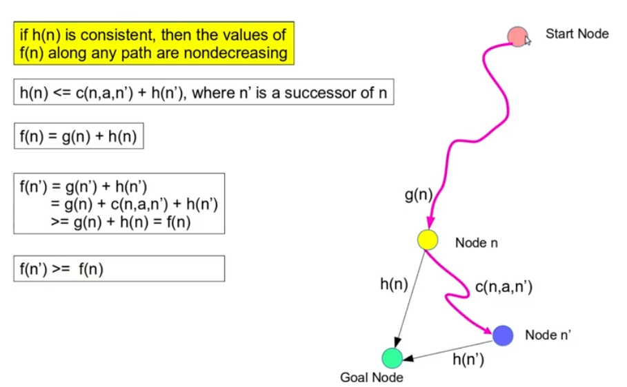
Optimality of A* Search Algorithm

Slide 43
Optimality of A* Search Algorithm
mmm

Slide 44
Optimality of A* Search Algorithm
mmm

Slide 45
Optimality of A* Search Algorithm
mmm

Slide 46
Optimality of A* Search Algorithm
mmm

Slide 47
Optimality of A* Search Algorithm
https://www.youtube.com/watch?v=5__0M9oezyA
https://www.youtube.com/watch?v=bFuYpf6-06o

Slide 48
Random Variable
The domain

